Slide 1
TREES Lecture # 19

Slide 2
APPLICATION AREAS
Trees are used to solve problems in a wide variety of disciplines. In computer science trees are employed to:
Construct efficient algorithms for locating items in a list.
Construct networks with the least expensive set of telephone lines linking distributed computers.
Construct efficient codes for sorting and transmitting data.
Model procedures that are carried out using a sequence of decisions, which are valuable in the study of sorting algorithms.

Slide 3
TREE
Trees are special kind of graphs.
A tree is a connected graph that does not contain any non-trivial circuit. (i.e. it is circuit-free).
A trivial circuit is one that consists of a single vertex.

Slide 4
EXAMPLES
.
TREE

Slide 5
EXAMPLES OF NON-TREES
In graph (a), there exists circuit, so not a tree.
In graph (b), there exists no connectedness, so not a tree.
In graph (c), there exists a circuit (also due to loop), so not a tree (because trees have to be a circuit free).

Slide 6
SOME SPECIAL TREES
TRIVIAL TREE:
A graph that consists of a single vertex is called a trivial tree or degenerate tree.
EMPTY TREE:
A tree that does not have any vertices or edges is called an empty tree.

Slide 7
FOREST:
A graph is called a forest if, and only if, it is circuit-free.
Hence, it clears that the connected components of a forest are trees.
Forest has two trees in it.

Slide 8
PROPERTIES OF TREES
A tree with n vertices has n - 1 edges. (where n ≥0). (Alternate definition of a tree)
Any connected graph with n vertices and n - 1 edges is a tree.
A tree has no non-trivial circuit; but if one new edge (but no new vertex) is added to it, then the resulting graph has exactly one non-trivial circuit.

Slide 9
A tree is connected graph, but if any edge is deleted from it, then the resulting graph is not connected.
Any tree that has more than one vertex has at least two vertices of degree 1.
A graph is a tree iff there is a unique path between any two of its vertices. (Alternate definition of tree)

Slide 10
EXERCISE
Explain why graphs with the given specification do not exist.
Tree with twelve vertices and fifteen edges.
Tree with five vertices and total degree 10.

Slide 11
SOLUTION
(i) Any tree with 12 vertices will have 12 - 1 = 11 edges, not 15. Hence solution of this tree is not possible.
(ii) Any tree with 5 vertices will have 5 - 1 = 4 edges.
Since, total degree of graph = 2 (No. of edges)
= 2(4) = 8
Hence, a tree with 5 vertices would have a total degree 8, not 10. that is why the solution of this tree is not possible.

Slide 12
EXERCISE
Find all non-isomorphic trees with four vertices.
SOLUTION:
Any tree with four vertices has 4 -1 = 3 edges.
Thus, the total degree of a tree with 4 vertices must be 6.

Slide 13
Every tree with more than one vertex has at least two vertices of degree 1.
1, 1, 1, 3 and 1, 1, 2, 2.
The corresponding trees:

Slide 14
EXERCISE
Find all non-isomorphic trees with five vertices.
SOLUTION:
Any tree with five vertices has 5-1 = 4 edges.
Thus, the total degree of a tree with 5 vertices must be 8.
Every tree with more than one vertex has at least two vertices of degree 1.

Slide 15
1, 1, 2, 2, 2 and 1, 1, 1, 2, 3 and 1, 1, 1, 1, 4

Slide 16
EXERCISE
Draw a graph with six vertices, five edges that is not a tree.
SOLUTION:
Two such graphs are:
First graph is not a tree; because it is not connected also there exists a circuit.
Similarly, second graph not a tree.

Slide 17
INTERNAL VERTEX & TERMINAL VERTEX
A vertex of degree 1 in a tree is called a terminal vertex or a leaf and a vertex of degree greater than 1 in a tree is called an internal vertex or a branch vertex.

Slide 18
EXAMPLE
v₁, v₂, v₅, v₆ and v₈ are terminal vertices.
v₃, v₄, v₇ are internal vertices.

Slide 19
ROOTED TREE
A rooted tree is a tree in which one vertex is distinguished from the others and is called the root.
The level of a vertex is the number of edges along the unique path between it and the root.
The height of a rooted tree is the maximum level to any vertex of the tree.

Slide 20
The children of any internal vertex v are all those vertices that are adjacent to v and are one level further away from the root than v.
If w is a child of v, then v is called the parent of w.
Two vertices that are both children of the same parent are called siblings.
Given vertices v and w, if v lies on the unique path between w and the root, then v is an ancestor of w and w is a descendant of v.

Slide 21
EXAMPLE
We redraw the tree as and see what the relations are:
We choose arbitrarily one vertex as a root.

Slide 23
EXERCISE
Consider the rooted tree shown below with root v₀
What is the level of v₈?
What is the level of v₀?
What is the height of this tree?
What are the children of v₁₀?
What are the siblings of v₁?
What are the descendants of v₁₂?

Slide 24
SOLUTION
What is the level of v₈?
The level of is v₈ is 3
------------------------------------------------------------------------------------------ Level 0
----------------------------------------------------------------------------------------- Level 1
----------------------------------------------------------------------------------------- Level 2
----------------------------------------------------------------------------------------- Level 3

Slide 25
What is the level of v₀?
The level of is v₀ is 0
------------------------------------------------------------------------------------------ Level 0

Slide 26
What is the height of this tree?
The height of this tree is 5.
------------------------------------------------------------------------------------------ Level 0
----------------------------------------------------------------------------------------- Level 1
----------------------------------------------------------------------------------------- Level 2
----------------------------------------------------------------------------------------- Level 3
----------------------------------------------------------------------------------------- Level 4
----------------------------------------------------------------------------------------- Level 5

Slide 27
What are the children of v₁₀?
The children of v₁₀ is v₁₄ , v₁₅ and v₁₆

Slide 28
What are the siblings of v₁?
The siblings of v₁ is v₂

Slide 29
What are the descendent of v₁₂?
The descendent of v₁₂ is v₁₇ , v₁₈ and v₁₉

Slide 30
BINARY TREE
A binary tree is a rooted tree in which every internal vertex has at most two children.
Every child in a binary tree is designated either a left child or a right child (but not both).
A full binary tree is a binary tree in which each internal vertex has exactly two children.

Slide 31
EXAMPLE
v is the left child of u

Slide 32
THEOREM
If k is a positive integer and T is a full binary tree with k internal vertices, then T has a total of 2k + 1 vertices and has k + 1 terminal vertices.
If T is a binary tree that has t terminal vertices and height h, then
t ≤ 2^{h}
Equivalently,
log₂t ≤ h

Slide 33
NOTE
The maximum number of terminal vertices of a binary tree of height h is 2^{h}.

Slide 34
EXERCISE
Explain why graphs with the given specification do not exist.
Full binary tree with nine vertices and five internal vertices.
Binary tree with height 4 and eighteen terminal vertices.

Slide 35
SOLUTION
(i) Any full binary tree with five internal vertices has six terminal vertices, for a total of eleven vertices (according to 2(5) +1=11), not nine vertices in all.
OR
As total vertices = 2k+1= 9
k = 4(internal vertices)
but given internal vertices = 5 ,which is a contradiction.
Thus there is no full binary tree with the given properties.

Slide 36
(ii) We have stated that terminal vertices t is less than or equal to 2^{h} . Where h is height.
Any binary tree of height 4 has at most 2⁴ = 16 terminal vertices.
Hence, there is no binary tree that has height 4 and eighteen terminal vertices

Slide 37
EXERCISE
Draw a full binary tree with seven vertices.
SOLUTION:
Total vertices = 2k + 1 = 7 (by using the above theorem)
k = 3 (internal vertices)
Hence, total number of internal vertices (i.e. a vertex of degree greater than 1) = k = 3
Total number of terminal vertices( i.e. a vertex of degree 1 in a tree) = k + 1 = 3 + 1 = 4

Slide 38
Hence, a full binary tree with seven vertices is:

Slide 39
EXERCISE
Draw a binary tree with height 3 and having seven terminal vertices.
SOLUTION:
Given height = h = 3
Any binary tree with height 3 has atmost 2³ = 8 terminal vertices.
But here terminal vertices are 7

Slide 40
We have stated that if there is k + 1 terminal vertices then there must be k internal vertices.
We have 7 terminal vertices, according to theorem we must have k = 6 Internal vertices, so binary tree exists and is as fellows:

Slide 41
We must have seven vertices at level 3.
------------------------------------------------------------------------------------------ Level 0
------------------------------------------------------------------------------------------ Level 1
------------------------------------------------------------------------------------------ Level 2
------------------------------------------------------------------------------------------ Level 3

Slide 42
REPRESENTATION OF ALGEBRAIC EXPRESSIONS BY BINARY TREES
We can represent any algebraic expression with the help of binary tree.
Binary trees are specially used in computer science to represent algebraic expression with arbitrary nesting of balanced parentheses.

Slide 43
EXAMPLE
We have given an algebraic expression a/b.

Slide 44
EXAMPLE
We have given algebraic expression a/(c+d).

Slide 45
EXERCISE
Draw a binary tree to represent the following expression
a/(b-c.d)
SOLUTION:
Note that the internal vertices are arithmetic operators, the terminal vertices are variables and the operator at each vertex acts on its left and right sub trees in left-right order.

Slide 47
TRAVERSAL ALGORITHMS
Procedures for systematically visiting every vertex of an ordered rooted tree are called traversal algorithms.
There are three of the commonly used such algorithms.
Preorder traversal
In-order traversal
Post-order traversal

Slide 48
PRE-ORDER TRAVERSAL
Let T be an ordered rooted tree with root r. If T consists only of r, then r is the preorder traversal of T.
Otherwise, suppose that T₁ , T₂ , . . . , T_{n} are the subtrees at r from left to right in T.
The preorder traversal begins by visiting r. It continues by traversing T₁ in preorder, then T₂ in preorder, and so on, until T₂ is traversed in preorder.

Slide 49
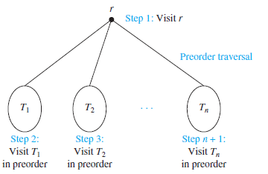
PRE-ORDER TRAVERSAL

Slide 50
STEPS IN PRE-ORDER TRAVERSE
Visit the root node.
Traverse to left sub-tree.
Traverse to right sub-tree.

Slide 51
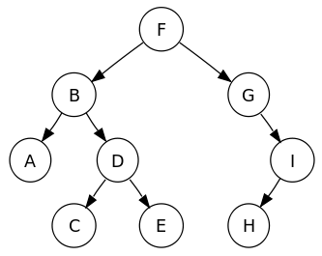
EXAMPLE
In which order does a preorder traversal visit the vertices in the ordered rooted tree T?
Output:
F
B
A
D
C
E
G
I
H

Slide 52
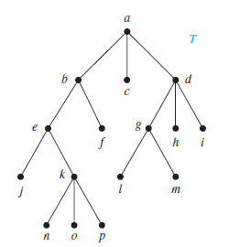
EXAMPLE
In which order does a preorder traversal visit the vertices in the ordered rooted tree T?
Output:
a
b
e
j
k
n
o
p
f
c
d
g
l
m
h
i

Slide 53
INORDER TRAVERSAL
Let T be an ordered rooted tree with root r. If T consists only of r, then r is the in-order traversal of T.
Otherwise, suppose that T₁, T₂, . . . , T_{n} are the subtrees at r from left to right.
The in-order traversal begins by traversing T₁ in inorder, then visiting r. It continues by traversing T₂ in inorder, then T₃ in inorder, . . . , and finally T_{n} in inorder.

Slide 54
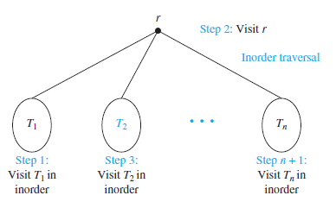
IN-ORDER TRAVERSAL

Slide 55
STEPS IN IN-ORDER TRAVERSE
Traverse to left sub-tree.
Visit the root node.
Traverse to right sub-tree.

Slide 56
EXAMPLE
In which order does a in-order traversal visit the vertices in the ordered rooted tree T?
Output:
A
B
C
D
E
F
G
H
I

Slide 57
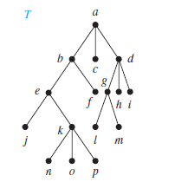
EXAMPLE
In which order does a in-order traversal visit the vertices in the ordered rooted tree T?
Output:
j
e
n
k
o
p
b
f
a
c
l
g
m
d
h
i

Slide 58
POSTORDER TRAVERSAL
Let T be an ordered rooted tree with root r. If T consists only of r, then r is the post-order traversal of T.
Otherwise, suppose that T₁, T₂, . . . , T_{n} are the subtrees at r from left to right.
The post-order traversal begins by traversing T₁ in postorder, then visiting r. It continues by traversing T₂ in postorder, then T₃ in postorder, . . . , and finally T_{n} in postorder.

Slide 59
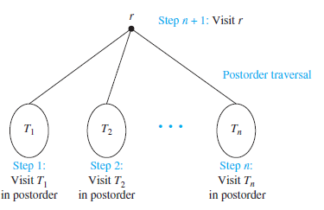

Slide 60
STEPS IN POST-ORDER TRAVERSE
Traverse to left sub-tree.
Traverse to right sub-tree.
Visit the root node.

Slide 61
EXAMPLE
In which order does a Post-order traversal visit the vertices in the ordered rooted tree T?
Output:
A
C
E
D
B
H
I
G
F

Slide 62
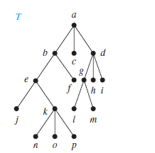
EXAMPLE
In which order does a post-order traversal visit the vertices of the ordered rooted tree T?
Output:
j
n
o
p
k
e
f
b
c
l
m
g
h
i
d
a

